Slide 1
‘Gaming' the system: Playing videogames for my degree
Part II: How to research a videogame
Notes:
Hello Everyone, and welcome back. This is the second half of ‘Gaming' the system: Playing videogames for my degree. In this set of slides, I will guide you through the process of writing an academic research project on a videogame, as inspired by my undergraduate dissertation. The title of which was…

Slide 2
Child’s Play:
‘Investigating sociocultural encodings of the figure of ‘The Child’ within Animal Crossing: New Leaf’
(Nintendo, 2013)
Nintendo EAD, (2013). Animal Crossing: New Leaf [Nintendo 3DS Video game], Frankfurt, Nintendo Co., Ltd.
Notes:
Child’s Play:
‘Investigating sociocultural encodings of the figure of ‘The Child’ within Animal Crossing: New Leaf’
(Nintendo, 2013)
Yes, this was a real research project, written by a student at the University of Cambridge. But what is a Research Project? Well basically it involves investigating a current issue, question, or debate in a particular field of scholarly enquiry. It normally involves developing a thesis statement, meaning the question you want to answer, some form of data collection, and an analysis of that data in a vigorous manner. The best research projects aim to fill some sort of gap, to tread where no scholar has gone before, and so on and so forth. My original aim when writing this project was to expand the field of educational enquiry. Lots of work had already been done regarding how childhood is represented within Children’s Literature, an important topic of enquiry, as it is generally accepted that children are taught about themselves, how to be children, and how to be adults, partially through the stories they are told and narratives they partake in. However, this research has seldom extended to videogames, except for the writing of some of the critics mentioned in the first part of this session. I had always loved the Animal Crossing franchise, which is built upon the notion of the child moving away from home to start a new life, and is presented through a very childlike, ‘cute’ aesthetic. Can you think of any games that might fit into this area of research? Or maybe you want to answer other questions, such as how gender, race, sexuality, or disability is represented? Take a moment to write down some ideas about your favourite game’s representation of certain groups. Now you have some preliminary thoughts, I will explain how to begin your research.

Slide 3
Step 1: Do a lot of reading!
Notes:
All good research projects will include a literature review, which is basically an overview of both your preliminary knowledge and the research that has already been done in the field. Because of this it's really important that, before you embark upon your research project, before you even pick up your game console of choice, you engage with a lot of previous reading. This could be from books in libraries or from online archive sites where academics will publish their research to make it accessible for people to read all over the world. Because of the Internet you no longer have to go to a library or a certain University in order to find particular knowledge, which actually makes it a lot easier to find reading for your literature review.
At first this might seem like a grand task- how on earth would you pick which texts to read when so many exist? Well by using keywords and reading the abstracts, which are small prefaces to academic research papers, you will be able to whittle down your options until you find a selection of texts that are perfectly suited to your project . A lot of people might see this preliminary reading stage as the least exciting part of the research project, but it is equally important as any data analysis. Through reading you will not only get a feel of the field and what is currently being written and thought, but you might also come across new opinions and new forms of thought that could aid your project, change your scope, or even make you what to write on something completely different. The reading stage is important because it furthers your knowledge and broadens your mind. Even though a lot of academic reading is text based, in the field of video game research there is a lot of information to be found in other forms such as through video essays or blogs, some links to which I have included in the further reading list, so it's important to not only limit yourself to text based inquiry. Once you feel that you've read enough , you will have a rudimentary bibliography which is the list of texts that informed your opinions and your project. My bibliographies are normally about two to three pages long, although this research project had a four page long bibliography which just goes to show how much reading it's important to do in order to create a fully informed project.

Slide 4
Step 2: Find your Question and Limit your Scope.
Notes:
After you have finished your preliminary reading, you should have a general idea of what you want to write about, which means it’s time to formulate your research question. Because there is only so long a research project can be, it’s important that you are not over-ambitious in your scope. For example, it would be nearly impossible to write a paper on every single Platforming game that has ever been released. Instead start small, with one game, or one particular issue, meaning that you have the space and time to really dive deep into your niche topic of research.
As an example, after conducting background research, I formulated the following research question: In what ways do the representations of child-animal relationships affirm or challenge socio-cultural constructions of childhood in modern Euro-American contexts?
So what does this mean? Well, I had decided that I wanted to explore how the child was presented in my game of choice, through analysing their relationships with the animals around them. Children and animals are traditionally seen as being linked, and so the presented differences between the two groups could tell us a lot about how we see the ‘child’ in the modern world. By limiting my research question to looking purely at how the child was constructed in relation to their surrounding environment, I was able to create a clear, focused line of argument and research.
I wanted this research to be valuable to educators and guardians alike, as it is important to know the values that are encoded in children’s literature, and how this may correspond or conflict with the values communicated in more formal learning environments, such as schools.
Can you think of any potential research questions that you may want to cover? Take a moment to write them down.

Slide 5
Step 3: Decide how you will perform your research/analysis
Notes:
Now comes the tricky bit- deciding how you will conduct your research. There are many different options available to you, and there is no one ‘perfect’ form of research method. You may want to conduct Quantitative analysis, which involves using numerical data, formulating data sets and performing statistical analysis. This sort of analysis might be useful for looking at player demographics, for example. If you wanted to investigate player response to a certain title, then you may choose to conduct Qualitative research, which involves conducting interviews and performing analysis based off of your interview transcripts. Alternatively, if you are more interested in analysing the actual content of the game, a library-based research project may be more suitable, which involves analysing the source material and secondary reading directly (the name gives you a clue here- imagine doing the analysis for your research sat in a library, without needing other participants). There are many different forms of research methodology, and these three options barely scratch the surface of the possibilities available to you. Many researchers choose to utilise a ‘mixed methods’ approach, meaning that they use more than one type of research methodology. For example, you may want to combine library-based and Qualitative research, where you analyse a primary text directly, but also interview players for a broader impression of the game’s affect on players. Whichever methodology or methodologies you choose, it’s also important to decide the types of data and information you will use. Will you use primary sources, by creating your own data for analysis, or will you analyse secondary data that has already been published?
Take a moment to pause the PowerPoint and brainstorm what sort of research methodology might be best for the questions you are interested in answering.
My research project utilised library-based methods rooted in analysis of primary sources, but my main research method was auto-ethnography, meaning onstead of qualitative interviews with other people, I chose to analyse myself, and my own gameplay experience, which I’ll talk more about now.

Slide 6
Carr’s (2013) Methodology
‘Player-as-analyst’
(Carr, 2017, pg.1)
Carr, D. (2017). Methodology, Representation, and Games. Games and Culture, 1555412017728641. https://doi.org/10.1177/1555412017728641.
Carr, D., Buckingham, D., & Schott, A. B. (2006). Computer Games: Text, Narrative and Play. Cambridge: Polity Press.
Notes:
An autoethnographic study constitutes a kind of close reading, and I followed a model proposed specifically for videogame research by Diane Carr. Carr’s (2017) strategy for analysing video games adapts an approach from literary studies where the researcher becomes their own subject, the ‘Player-as-Analyst’.
The chosen analytical and research methods essentially required using myself as a subject. On one hand this could be criticised, as by not analysing data based on the child player’s response when the entire project is based around the child and the animal, my research was arguably flawed, and very subjective. However, I would refute this. Firstly, when collecting and analysing data based upon another person’s experience, one ventures into dubious territory, as small details may be missed, and meaning can always get lost in the conversational space created between interviewer and interviewee. A videogame is only fully understood in the moment that it is played, but much of what makes play meaningful is invisible to the observer of the player. Observing on-screen action alone would have resulted in the physical, tactile side of gameplay not being fully communicated to me as researcher, not would I be able to completely understand what my interview subject was feeling or thinking. Although it is arguable that a researcher could access the player’s cognitive processes by conducting semi-structured interviews after the playing event, it is unlikely that a player could recall and replicate the complexities of their playing experience. Furthermore, in terms of the limited scale of the project, and the amount of time that would need to be dedicated through interviewing, transcribing and coding processes would not meet the required standard that I wished to uphold. In order to create a worthwhile, academically reinforced and valid piece of research, a large number of children, parents, teachers and other guardians, along with academic scholars would have needed to be interviewed. Due to the amount of time I want dedicated to gameplay, any sample of people I would be able to interview would be extremely limited, and almost unobservable in terms of the level of rigour required. Given the time span of this project, which was my final year at university, I didn’t have the necessary means of conducting a large-scale research project, meaning qualitative methods would not lead to as useful a piece of research as approaching it through a more theoretical lens.
I will now briefly explain Carr’s methodological tools. As we go through the next few slides, please consider how appropriate this methodology would be for your own research.

Slide 7
Carr’s (2013) Methodology
Preliminary Play
Thorough note-taking
Anecdotes
Carr, D. (2017). Methodology, Representation, and Games. Games and Culture, 1555412017728641. https://doi.org/10.1177/1555412017728641.
Carr, D., Buckingham, D., & Schott, A. B. (2006). Computer Games: Text, Narrative and Play. Cambridge: Polity Press.
Notes:
Carr’s proposed process involves playing the chosen game, pausing at regular short intervals to take impression notes regarding themes, visuals and the implementation of encoded values. After each game has been played for a substantial amount of time, these notes will be collated and summarised. It is expected that patterns will be identified, and from the analysis, certain sections of the games will be replayed, and notes taken more thoroughly, pausing the game every one or two minutes to record observations. The purpose of this second round of note taking, along with providing more material for detailed analysis, will be to record events and particular moments within the games, and to mindfully interrogate player response. This approach is cognitive in that first taken into account is player strategy, then emotional response inspired by narrative. The specific embodied response will also be recorded, for example ‘the X button was tapped so rapidly that my thumb is aching’ or ‘my breathing is fast’. These notes will eventually be accumulated to create a matrix of signs and corresponding player responses, from which will be written longform ‘anecdotes’, focusing on both specific moments and overall themes, in a similar manner to how a literary review would be written, for example, the type that you do at A-Level. These ‘anecdotes’ will be in the first person, reflecting the researcher’s position as a ‘player-as-analyst’ (Carr, 2017, pg.1), and will be thoroughly forward with the recognition of their own subjectivity. From these ‘anecdotes’ and notes, analysis will be performed, which will provide evidence and grounding to discuss how the encoded values and themes relate, for me, to the child.

Slide 8
Carr’s (2013) Methodology- The Five Plains
Visual
Verbal/Text
Auditory
Mechanics
Haptic
Carr, D. (2017). Methodology, Representation, and Games. Games and Culture, 1555412017728641. https://doi.org/10.1177/1555412017728641.
Carr, D., Buckingham, D., & Schott, A. B. (2006). Computer Games: Text, Narrative and Play. Cambridge: Polity Press.
Notes:
In terms of methods for research and analysis, this data is organised and analysed through drawing comparisons according to the following five semiotic plains, meaning the plains where meaning is made, within videogame analysis
- The Visual plain refers to Character and world design, colour pallete, art style, screen and scene composition, anything you can see whilst playing the game
– The Verbal or Texual plain refers to the placing and use of text, font, lexis, etc
- The Auditory Plain, meaning diegetic noise, such as voice acting or ‘action’ noises, but also ambient sound and music
– The Mechanic Plain refers to the interactive element of the game. The possible actions that the player and character can perform, but also the lexis used in relation to these actions. For example, if there is a sheep pictured onscreen, and the only two options available to the player are ‘shear’ and ‘kill’, then this communicates key information about the relationship between humans and animals.
-And finally the Haptic Plain. This encompasses the tactile, physical player experience of gameplay. Controller design, button layout, whether the game has one screen or two, the console itself, etc.
All of these semiotic planes inform and affect each other, and during the gameplay experience, meaning is created in between these plains. Videogame analysis, like other forms of media and literature, involves observing the nuanced relationship between these planes, and theorising how this ecosystem of meaning is created. Through analysis of these plains, we may uncover a number of embedded comments and ideologies across many themes.
Now that I’ve explained these plains, take a minute to write down some moments from your favourite games where the plains interact

Slide 9
Step 4: Customise your analytical tools
Notes:
If none of the research methodologies I’ve spoken about sounds completely suitable for the type of game you want to write about, or the sort of question you’d like to answer, then it’s important to remember that you are more than welcome to adapt or customise another person’s research, as long as you give them credit for the original idea. If that isn’t enough, you can even create your own tools!
For example, in relation to my project, Carr’s methodology is not entirely suitable for life simulators (games not based around any linear narrative, but instead on the everyday routines of individual player-controlled characters), due to the gameplay being based on organic interaction as opposed to scripted narrative, thus making exact interactions or events difficult to replicate for the sake of creating ‘anecdotes’. In order to remedy this, Carr’s established methodology was modified, examining patterns of ‘actions’ rather than specific scenarios, along with the recognition that most of these events require triggering, so the ‘moment’ of triggering must also be recorded. I also customised my own research tools, one of which involved giving characters numeric ratings based upon their ‘animal’ and ‘childlike’ traits, so that I could analyse characters and the constructions of childhood and animality more rigorously.
Take a moment to get creative, what other methods of analysis can you think of that might help you answer your research question? Then, once you have theorised some research tools, it’s time to…

Slide 10
Step 5: Write, write, and write some more!
Notes:
Write, write, and write some more! Look at the data you’ve collected- how does this help you to answer your research question? Don’t put too much pressure on yourself to craft a perfectly-formed piece of writing straight away. Just sit down with your notes and see what comes out. The point of writing about videogames, aside from furthering the field of research, is to engage more thoroughly with something you really enjoy. I know that when I’m writing about the things I love, it is much easier to stay focused and feel proud of the work I’ve created.

Slide 11
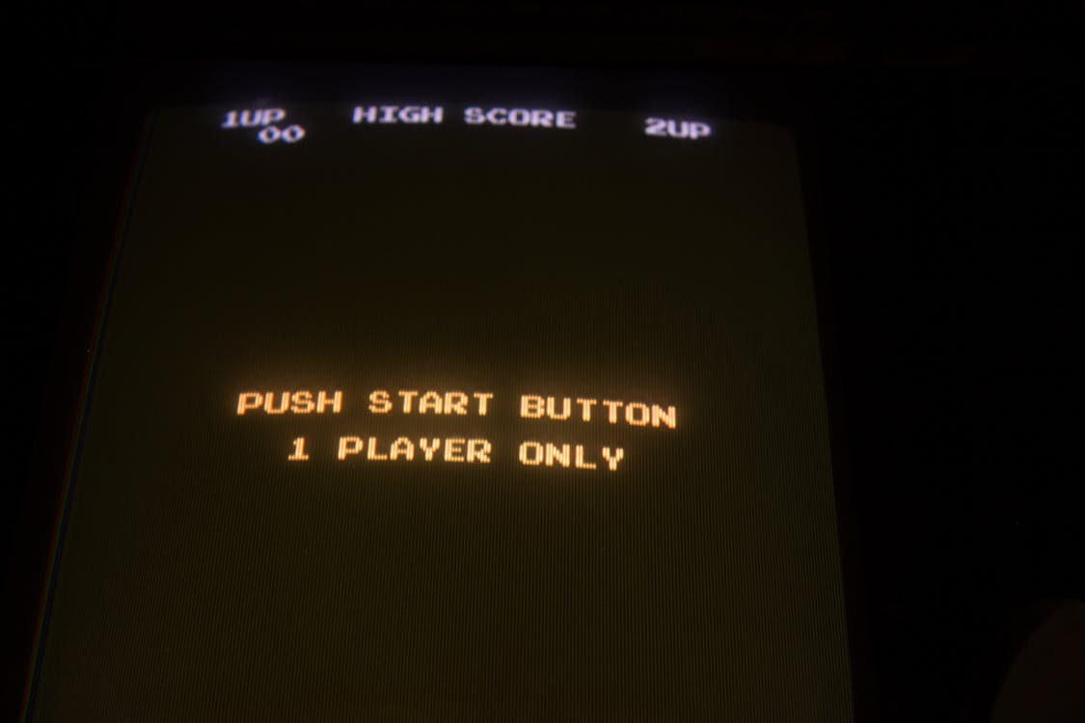
Now Go and Play!
Dark Indigo. (2017). Push Start Button Screenshot · Free Stock Photo. https://www.pexels.com/search/GAMES%20CONSOLE%20PAPER/
Notes:
And that brings us to the end of this session. I hope that through these slides I’ve prompted you to question some of your previous notions about what academic writing and research looks like, and what options you have available to you for further study. It’s important to remember that you can always find a way to write about the topics you’re passionate about, whatever they are. I also hope that you will leave this session prepared to think more deeply about the games you play, how they convey meaning and any underlying ideologies they might endorse. There is an activity sheet included in this resource pack that will help you to perform some preliminary analysis on a title of your choice. Thank you very much for listening, now please go and play a videogame, they’re very fun.

Slide 12
References
Carr, D. (2017). Methodology, Representation, and Games. Games and Culture, 1555412017728641. https://doi.org/10.1177/1555412017728641.
Carr, D., Buckingham, D., & Schott, A. B. (2006). Computer Games: Text, Narrative and Play. Cambridge: Polity Press.
Nintendo EAD, (2013). Animal Crossing: New Leaf [Nintendo 3DS Video game], Frankfurt, Nintendo Co., Ltd.

